Slide 1
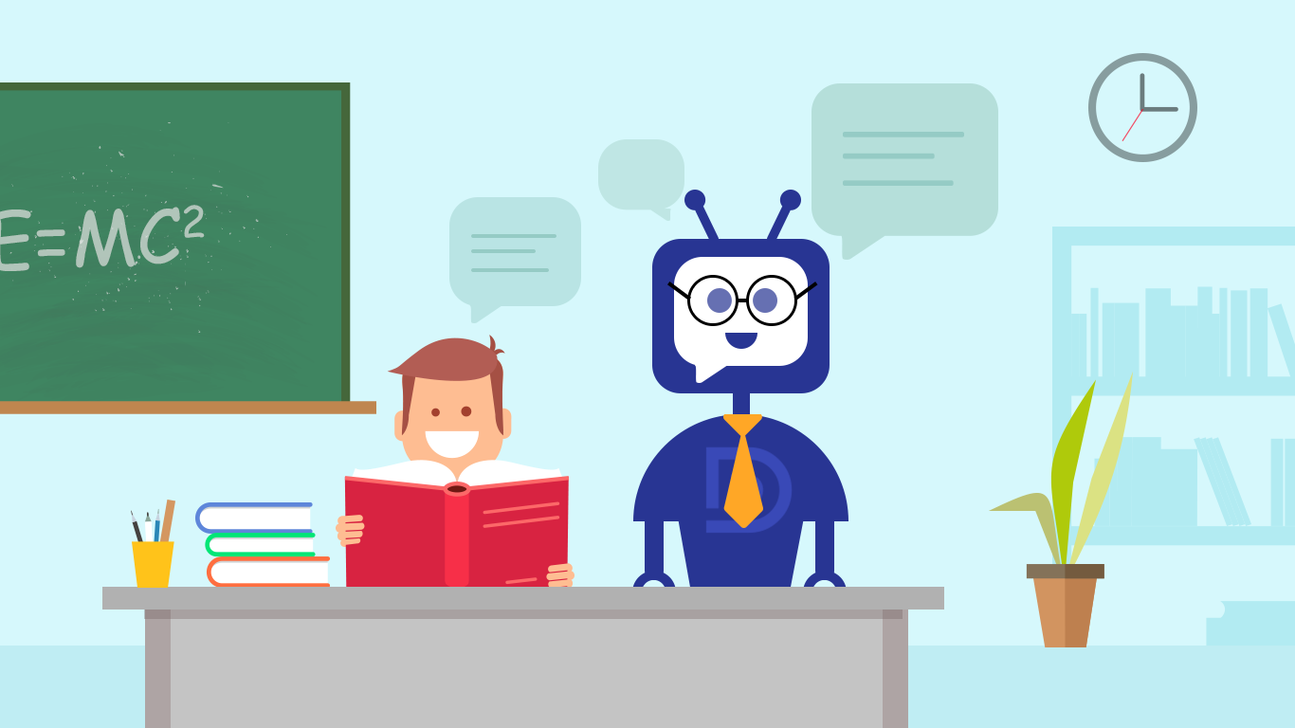
Study Chatbot Using NLP and ML

Slide 2
TEAM MEMBERS: Mehwish Gado Abdul Qadeer Muhammad Usman Muhammad Yousif

Slide 3
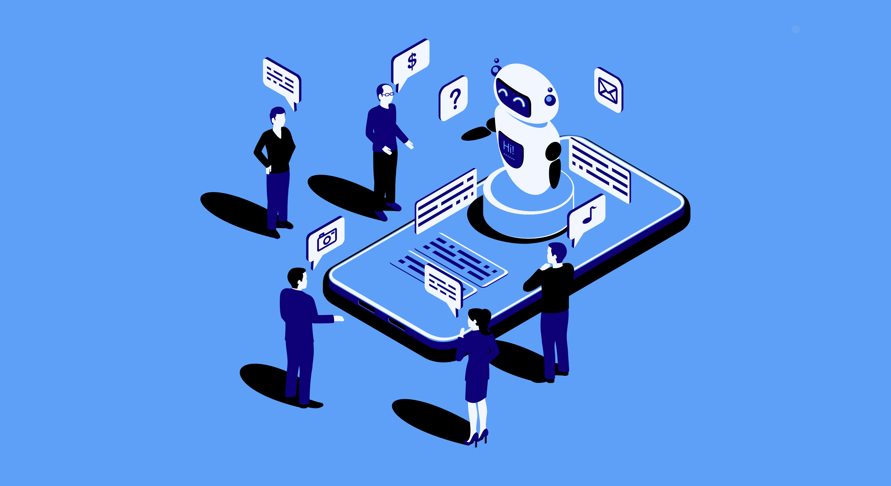
Purpose of the Project
Enhance learning with automated academic assistance.
Build an intelligent, interactive study tool.

Slide 4
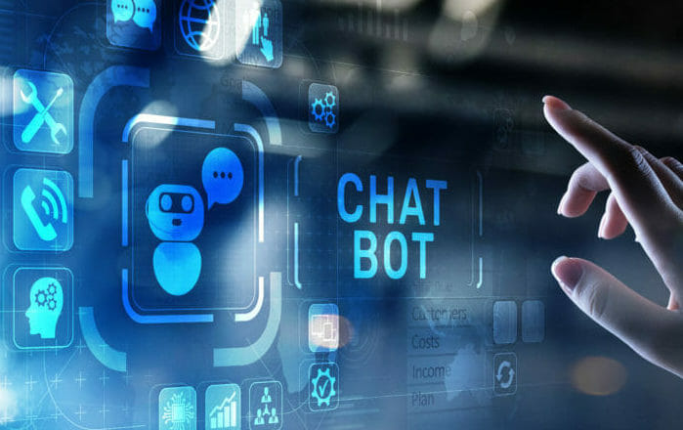
Objectives of the Project
Automate
Automate responses to academic queries.
Use
Use NLP and ML for query classification.
Provide
Provide real-time assistance and continuous improvement.

Slide 5
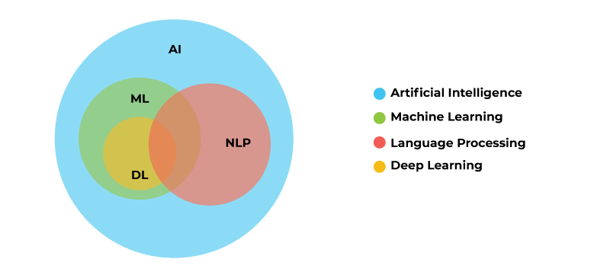

Slide 6
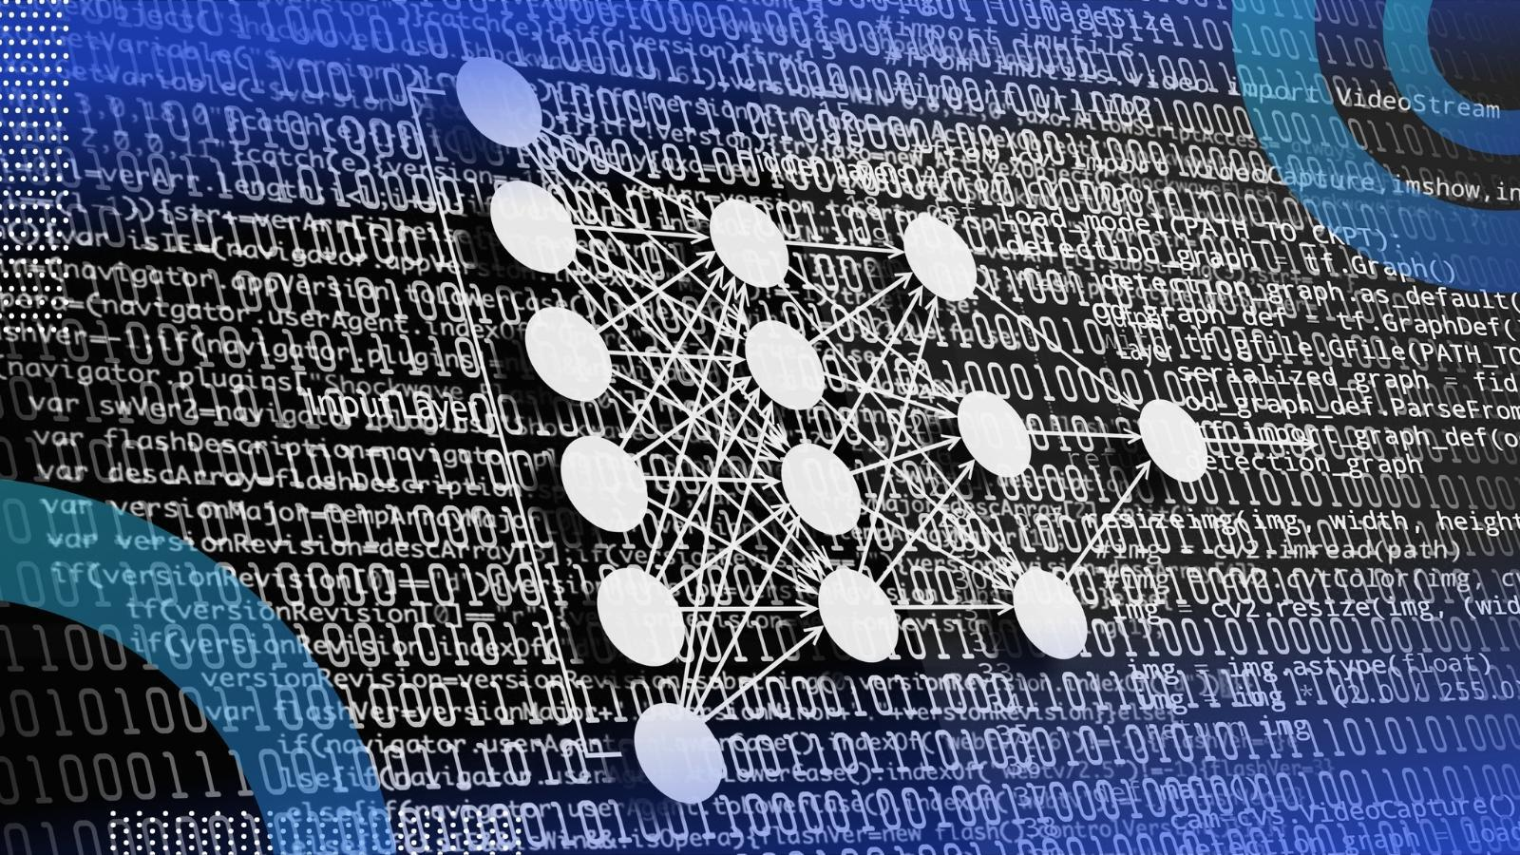
Introduction to NLP and ML
Natural Language Processing (NLP) and Machine Learning (ML) are two foundational technologies that drive the chatbot's capabilities in understanding and responding to user input.

Slide 7
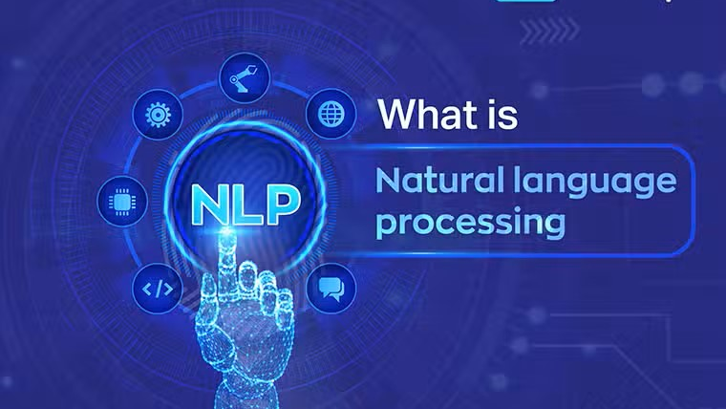
NLP enables computers to interpret and generate human language, allowing a machine to understand user inputs.

Slide 8
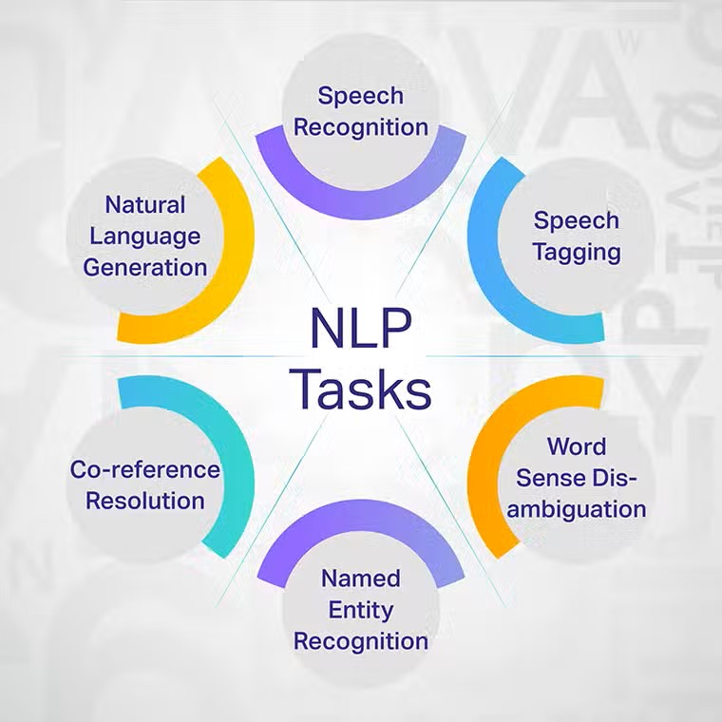

Slide 9
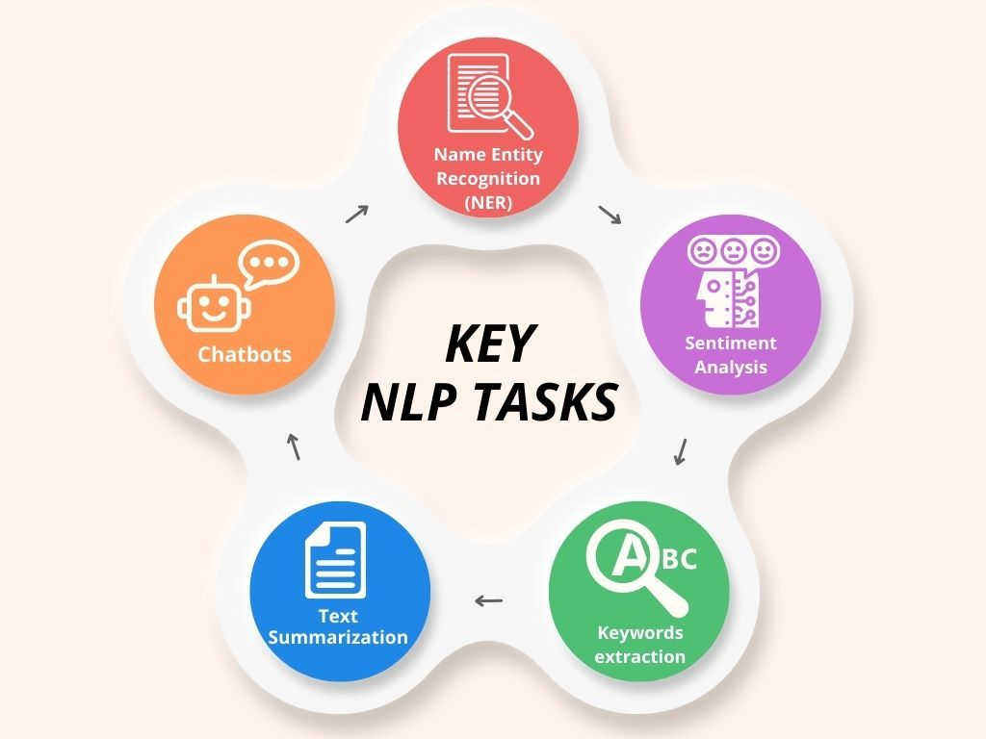
Key Tasks in NLP
Text Preprocessing
Part-of-Speech Tagging
Named Entity Recognition
Sentiment Analysis
Machine Translation

Slide 10
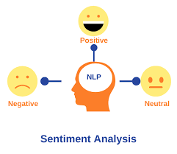
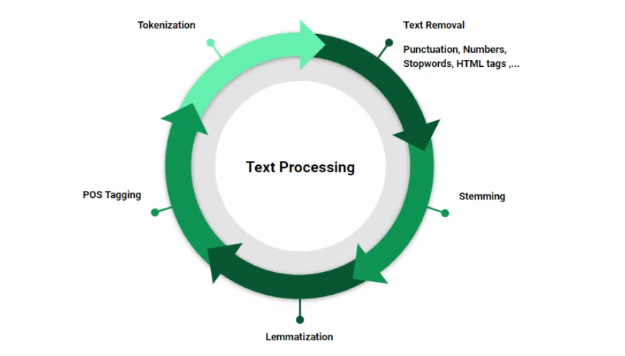
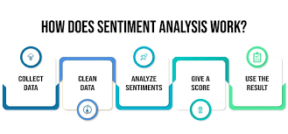
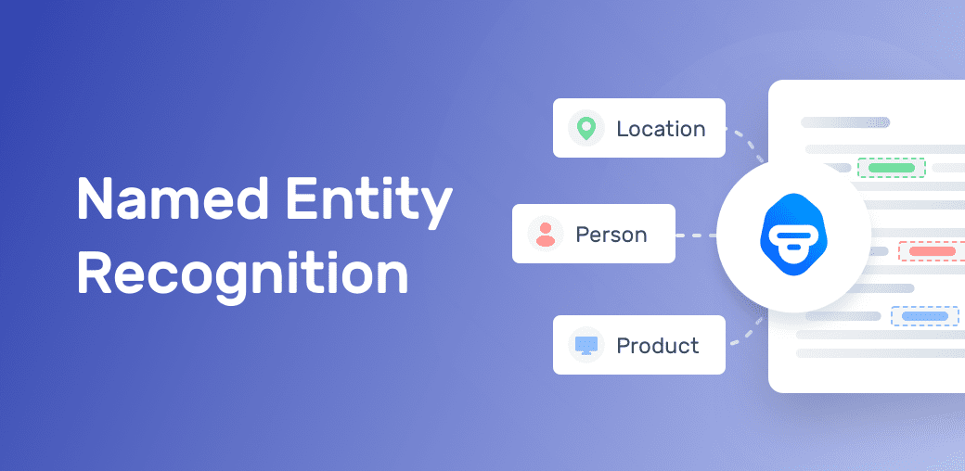
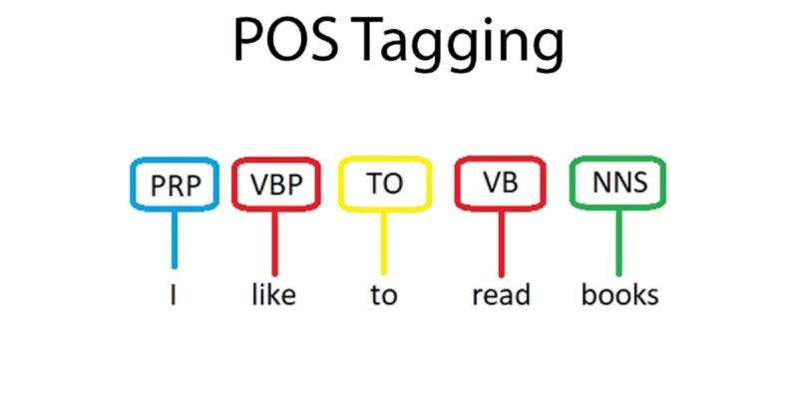

Slide 11

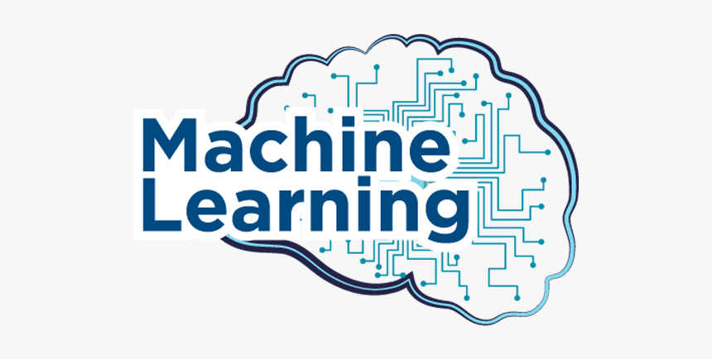
What is Machine Learning (ML)?
ML involves algorithms that learn patterns from data to make decisions without explicit programming.

Slide 12
Types of Machine Learning
Supervised Learning
Unsupervised Learning
Reinforcement Learning

Slide 13
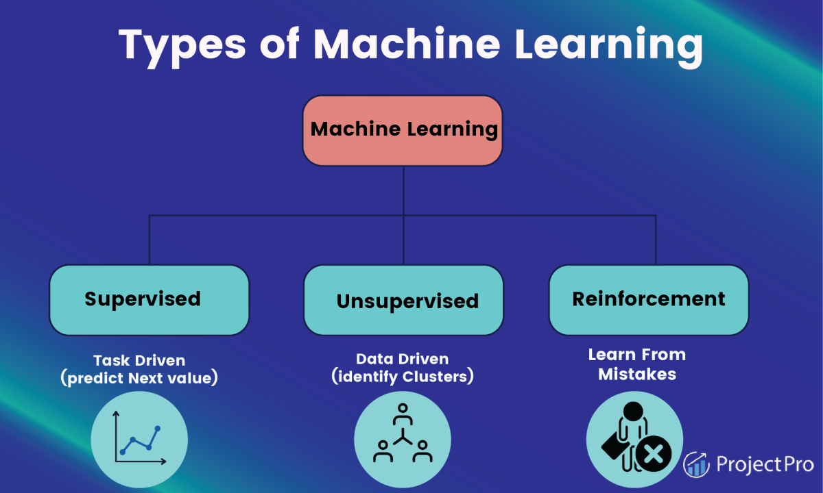

Slide 14
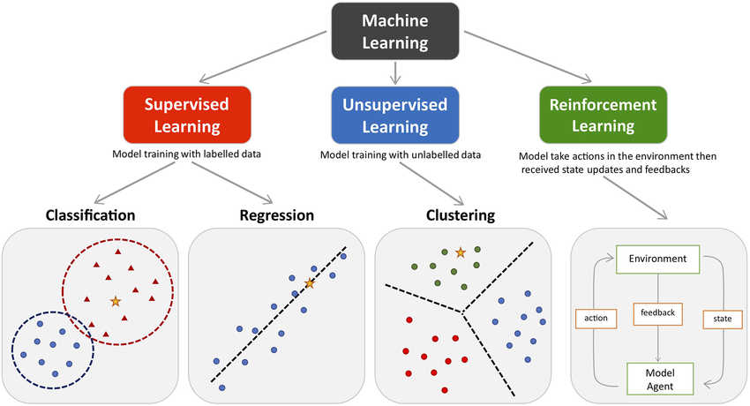

Slide 15

How NLP and ML are Integrated in Your Study Chatbot
NLP helps process and understand user input, while ML classifies and matches responses based on user queries.

Slide 16
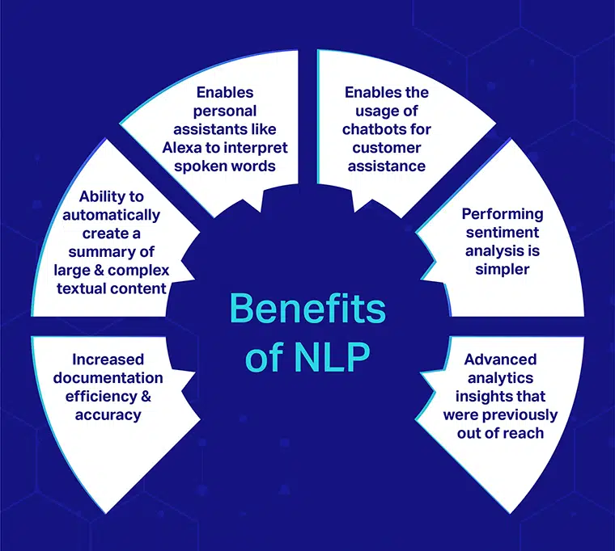
Why Use NLP in Your Chatbot?
Understanding User Inputs
Contextual Relevance
Text Classification

Slide 17
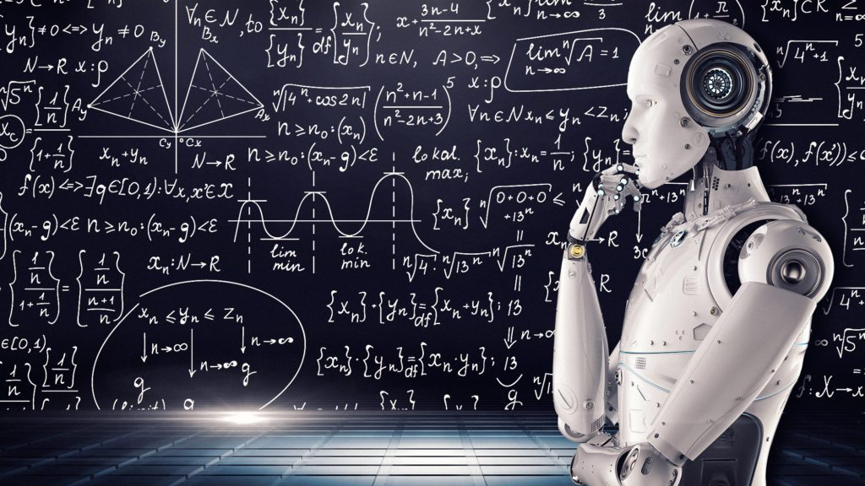
Why Use ML in Your Chatbot?
Intent Classification
Continuous Improvement
Personalization

Slide 18
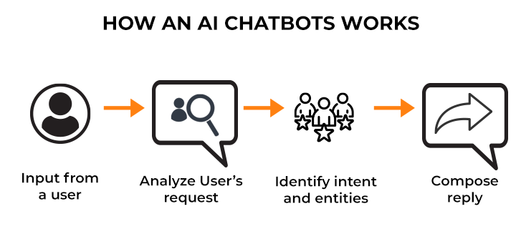
How Chatbot Works - User Interaction
Notes:
The user interacts with the chatbot, and NLP processes the input to extract key features for intent classification.

Slide 19
Methodology
Data Collection: Queries labeled into intents (e.g., greetings, math help).
Text Preprocessing: Tokenization, lemmatization, and stop-word removal.
Feature Extraction: Convert text to numerical vectors using TF-IDF.
Model Training: Use Logistic Regression for intent classification.
Response Generation: Match queries via Cosine Similarity to predefined responses.
User Interface: Built with Tkinter for a user-friendly GUI.
Continuous Learning: Enhance the chatbot with new interaction data.

Slide 20
ALGORITHMS
TF-IDF Vectorizer: Converts text to numeric features.
Logistic Regression: Classifies user intents.
Cosine Similarity: Matches user queries to responses.
NLP Techniques: Tokenization and lemmatization.
Algorithms

Slide 21
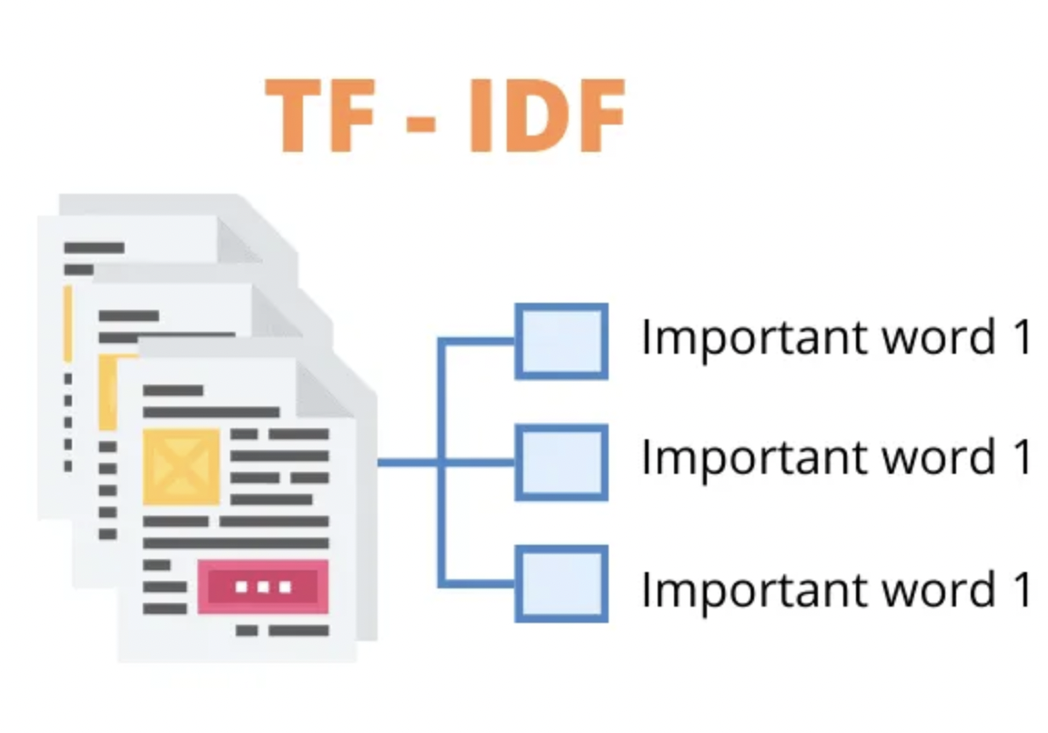
Role of ML in Chatbot - Feature Extraction with TF-IDF
TF-IDF converts user input into numerical vectors, helping the model evaluate the importance of words and classify intents accurately.

Slide 22
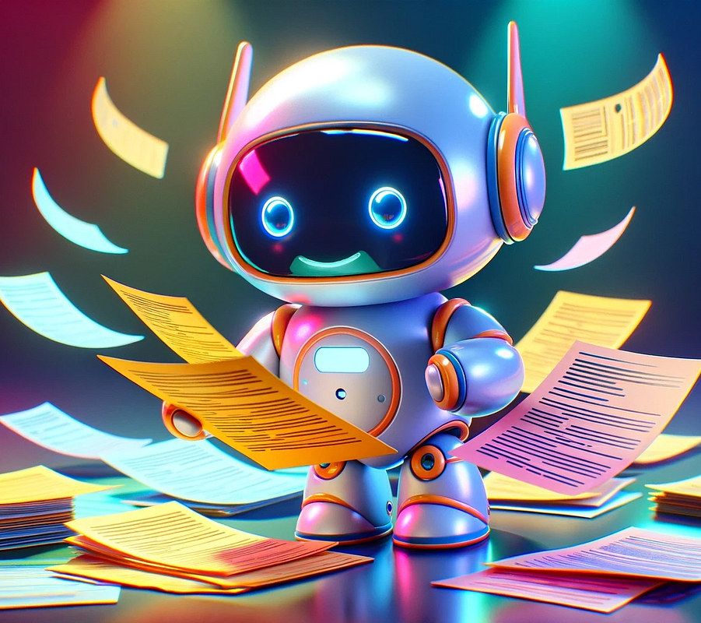

Role of ML in Chatbot - Intent Classification
The ML model classifies queries into categories such as coding help, motivational quotes, or study advice.

Slide 23
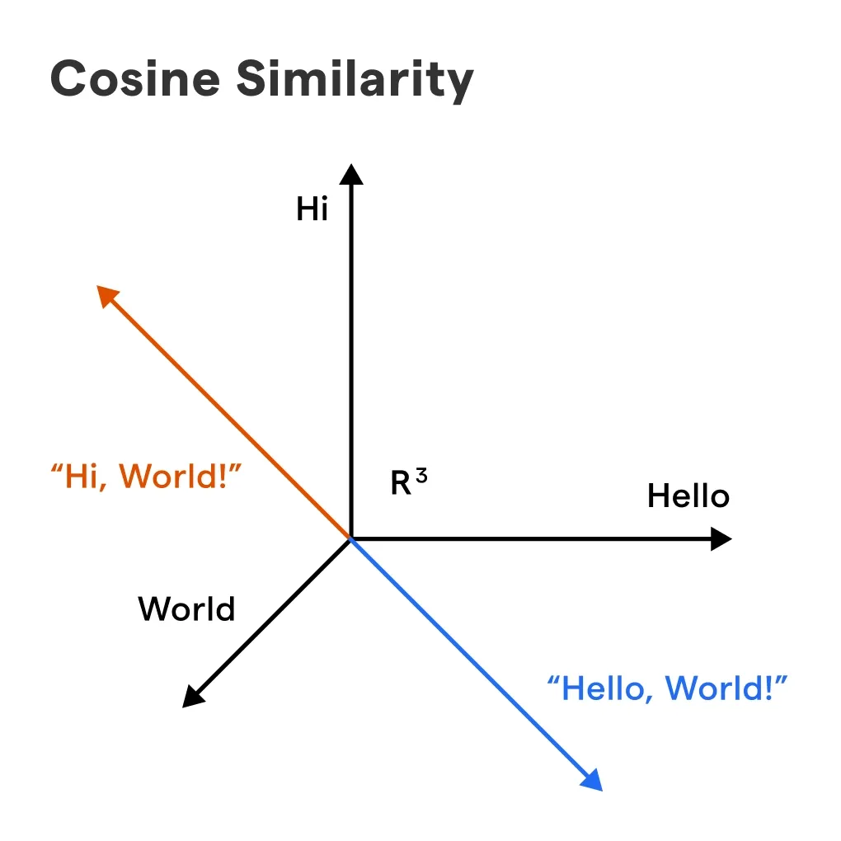
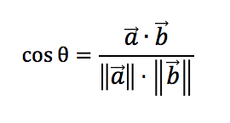
Role of ML in Chatbot - Cosine Similarity for Response Matching
Cosine similarity compares user input with stored responses to find the most relevant match and provide the best response.

Slide 24
Role of NLP in Chatbot - Text Preprocessing

Slide 25
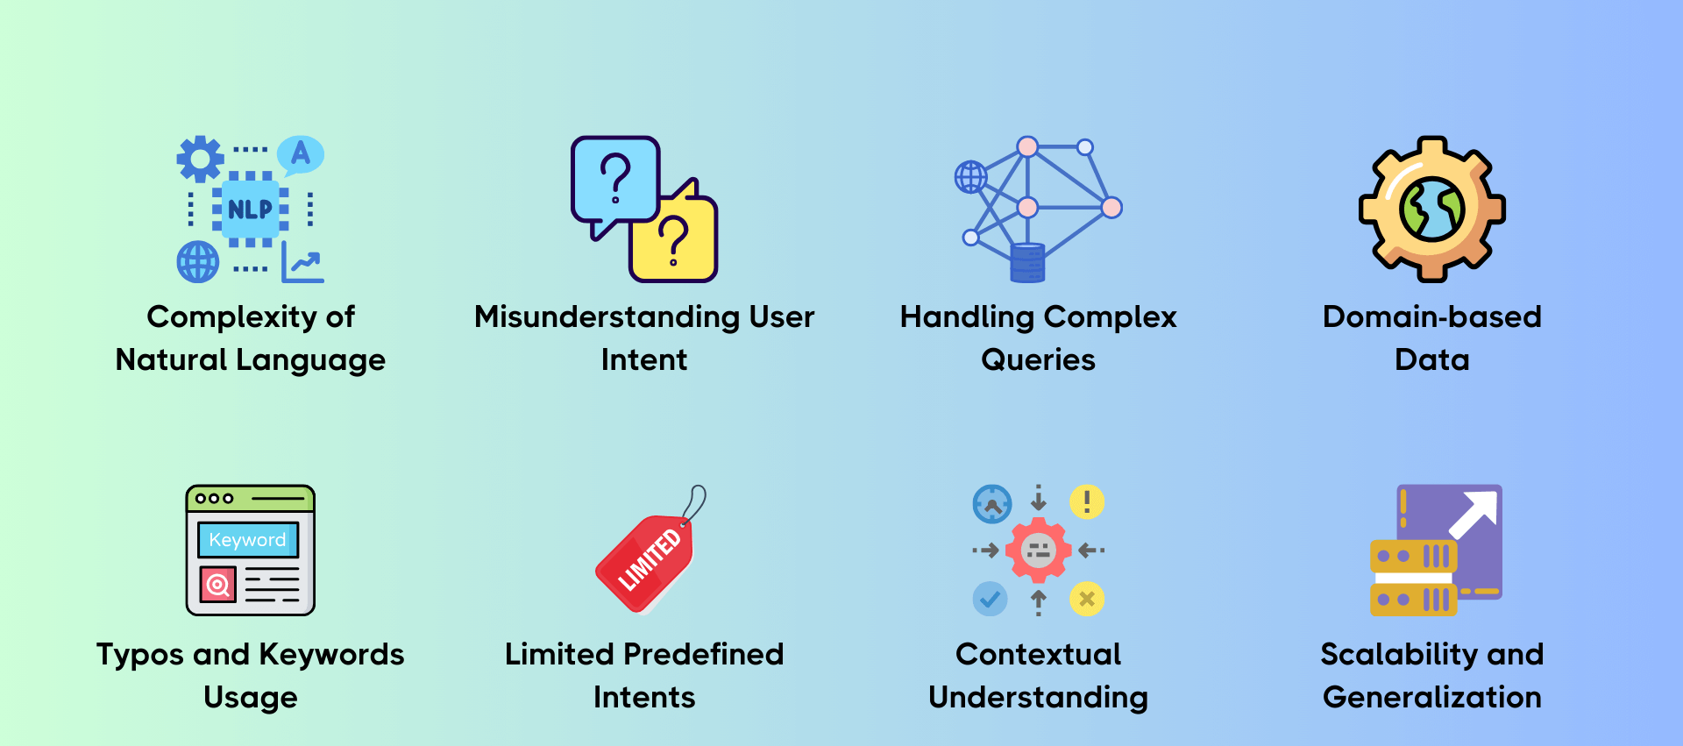
Role of NLP in Chatbot - Intent Recognition
Notes:
NLP algorithms like TF-IDF and word embeddings help recognize the intent behind user queries, such as coding help or study tips.

Slide 26
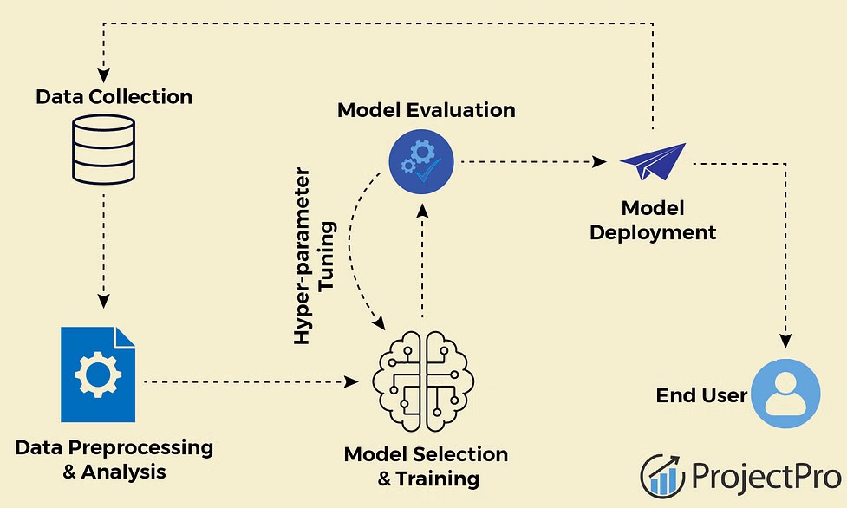
Role of ML in Chatbot - Training the Model
Notes:
The ML model (Logistic Regression) is trained on a labeled dataset of possible user queries and their corresponding intents.

Slide 27
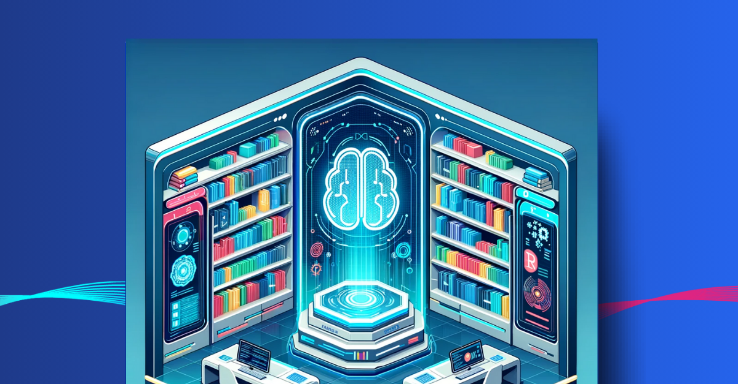
Libraries Used
Tkinter: GUI creation for user interaction.
nltk: Text preprocessing (tokenization, lemmatization).
sklearn:
TF-IDF Vectorizer: Converts text to numerical format.
Logistic Regression: Intent classification.
Label Encoder: Encodes intents into numeric labels.
Cosine Similarity: Matches input with responses.
random: Generates varied responses.

Slide 28
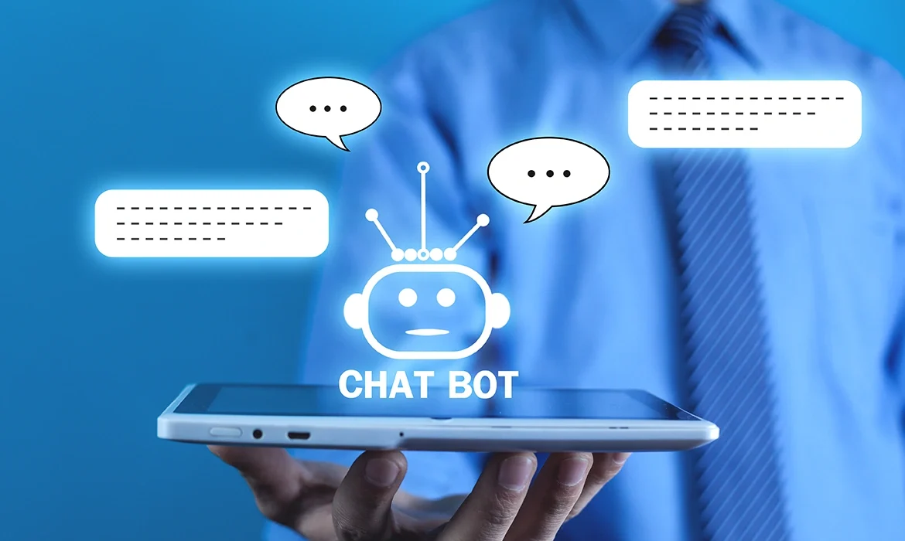
Why Use NLP and ML in Chatbot
Notes:
Real-time responses, scalability, user engagement, and improved accuracy make NLP and ML essential for an effective chatbot.

Slide 29
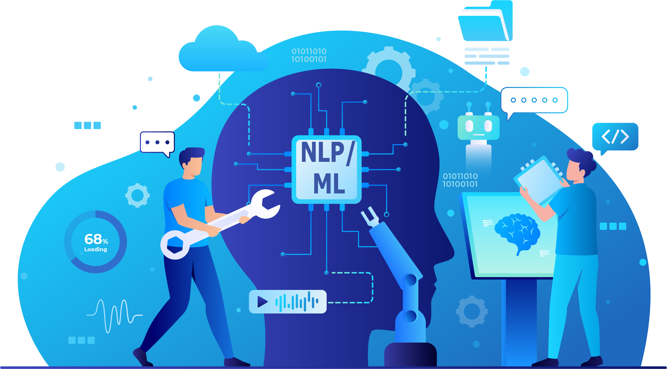
Benefits of NLP and ML
Real-Time Response
Scalability
User Engagement
Improved Accuracy Over Time
Handling Ambiguity and Variations

Slide 30
Future Enhancements for the Chatbot
Integration with more study platforms, support for voice-based interaction, and further personalization using advanced ML models.

Slide 31

Continuous Improvement of the Chatbot
As the chatbot interacts with users, new data is fed back into the ML model, helping it become more accurate and effective.

Slide 32

Conclusion
The Study Chatbot using NLP and ML helps students by providing real-time assistance, personalized responses, and continuous improvement over time.

Slide 33

https://github.com/MuhammadYousifKhan/AI-Study-Chatbot-Using-NLP-and-ML.git
GitHub Repository of Our Project

Slide 34
Thank You
Any Questions?

